Slide 1
TAYABASCARE: PRESCRIPTIVE ESTABLISHMENT VIOLATIONS USING HISTORICAL INSPECTION DATA FOR CITY HEALTH OFFICE OF TAYABAS CITY
Aeron James P. Fontanilla Christian Nemesius Cedeno Reyes
Charlie Mercado Kurt Panaligan

Slide 2
AGENDA
Introduction
Background of the problem
Objectives
Scope and Limitations
Technology used
Methodology
Result and Discussion

Slide 3
INTRODUCTION
TayabasCare is prescriptive establishment violations using historial inspection data is to developed for the City Health Office of Tayabas City. It modernizes the documentation and monitoring of sanitation inspections of establishments within the city's jurisdiction by storing inspection records in a centralized database where they can be retrieved, reported, and analyzed to support evidence-based decision-making .

Slide 4
Background of the Problem
The problems faced by the office was the redundant encoding of establishment data across different reporting periods. The office was mandated to collect sanitation data from establishments on a monthly and quarterly basis to comply with Department of Health reporting requirements and local government monitoring protocols. However, due to the absence of an integrated database system, sanitation inspectors were compelled to encode the same establishment information multiple times to generate reports for each time period. This repetitive data entry process was not only time-consuming and inefficient but also significantly increased the risk of data entry errors, inconsistencies, and discrepancies across different reports.

Slide 5
Objectives
1.The study gathered, consolidated, and digitized historical inspection data from the City Health Office of Tayabas City into a structured database.
2.The study analyzed historical inspection data to identified violation patterns and established risk scoring criteria based on establishment characteristics and compliance history.
3.TayabasCare was designed and implement as a web-based platform that manages inspection records, calculates risk scores, and supports inspection scheduling and documentation.
4.Automated risk assessment and notification features that prioritize high-risk establishments and alert personnel about inspection schedules and compliance issues.
5.Analytical dashboards and reporting features that visualize violation trends, compliance statistics, and establishment risk distributions for informed decision-making.

Slide 6
Scope and Limitation
•Secure Login and User Authentication = The system ensured users are properly identified and verified before accessing system features. It includes individual user account creation with unique usernames, secure activation processes, and session management that logs users out after inactivity. This protects sensitive establishment and inspection data from unauthorized access.
•Password and Authenticator Protection= The system enforced strong password policies including minimum length, complexity requirements, and regular expiration. It offers optional two-factor authentication through SMS or email verification. Passwords are stored using encryption to prevent unauthorized access and protect against common security threats.
Draft Saving and Report Continuity= Users can save incomplete reports and continue data entry at their convenience without data loss. The system provides automatic and manual draft-saving functionality, allowing users to access their drafts from any device. This reduces the burden of completing lengthy reports in single sessions and encourages more thorough reporting.
Submission History and Audit Trail= The system maintained a comprehensive archive of all submitted reports with timestamps and submitter information. Users can view previously submitted reports, compare current conditions with historical data, and track compliance progress over time. This creates transparency and provides evidence for enforcement proceedings when necessary.
Sanitation Indicator Monitoring and Data Collection= The system collected data on specific sanitation indicators including waste disposal practices (solid and liquid waste management), water source safety, and toilet/restroom facilities (availability, condition, and handwashing stations). Users can upload photos and supporting documents to verify reported conditions.
•System Modules= The system comprised five integrated modules: the User Management Module handles account administration and role-based access for CHO personnel, the Establishment Registration Module maintains the institutional inventory of all establishments requiring monitoring; the Inspection and Data Collection Module coordinates field inspections and enables systematic documentation of compliance status, violations, and corrective actions; the Reporting Module generates automated performance reports to assess compliance levels and plan interventions; and the Dashboard Module serves as the central control center, consolidating system-wide metrics, inspection activities, and compliance trends into a unified interface with real-time insights and graphical representations.

Slide 7
TECHNOLOGY USED
Build and data
PHP, HTML, CSS, JavaScript
MySQL database
XAMPP v3.3.0 (local server)
Visual Studio Code v1.105.1
Design and documentation
Figma (UI prototypes)
Canva (visual materials)
Google Drive (file sharing)
Microsoft Word v2404
Hardware
Lenovo: Ryzen 5 6600H, 8 GB
Asus: Celeron N4020, 8 GB
HP: Ryzen 3 2200U, 4 GB
Redmi Note 12 (mobile testing)

Slide 8
Methodology
The proponents utilized the Agile Methodology, specifically the Iterative Agile Model, throughout the development of TayabasCare: Prescriptive Establishment Violations Using Historical Inspection Data for City Health Office of Tayabas City to ensure that the system is built efficiently and continuously improved.
Planning Phase = The proponents identified the goals and scope of the project. The proponents outline the objectives of TayabasCare and determine the features needed for the web-based sanitation environmental health data collection and reporting system for Tayabas City. The proponents gather relevant data by conducting interviews with City Health Office staff, environmental health officers, and establishment owners, observing the current data collection and reporting process, and reviewing existing records and sanitation inspection procedures. The proponents analyze this data to understand the system requirements and identify any potential challenges.
Designing Phase= The design is built to meet the specific requirements of the City Health Office, ensuring that the system supports efficient data collection, sanitation inspection management, report generation, and establishment information accessibility. The proponents also prepare prototype interfaces and design documents for client review and approval, ensuring that all aspects of the system align with the operational needs of the City Health Office and comply with sanitation standards and regulations.
Developing Phase= the proponents begin building TayabasCare based on the designs created in the previous phase. The proponents write the necessary code, configure the database, and integrate the system's features to ensure it functions as intended including the data collection system, establishment profiling, sanitation inspection records, prescriptive risk scoring engine, reporting and analytics dashboard, and other essential components of the system,
Testing Phase = the proponents conducted initial tests to verify that each feature works correctly and meets the requirements of the City Health Office. The proponents ensure that the system is reliable, efficient, and ready for the next phase, addressing any issues or bugs that may arise to maintain system quality and functionality.

Slide 9
Deploying Phase = proponents finalized all components of TayabasCare and ensure that the system is fully tested and validated. The system is installed on the server, user accounts are configured, and access is provided to authorized users from the City Health Office and registered establishments. All modules, including the data collection, establishment profiling, sanitation inspection, prescriptive risk scoring, and reporting systems, are made fully operational and integrated with the existing workflow.
Reviewing Phase = the proponents observe its performance and collect feedback from the users and this phase marks the operationalization of the system, as the City Health Office uses the system to collect, manage, and report sanitation environmental health data for establishments in Tayabas City more efficiently.
Launching Phase = proponents released TayabasCare for full operation and make the system accessible to all intended users. The initial use is monitored to ensure that all features, including the data collection, establishment profiling, sanitation inspection records, prescriptive risk scoring, and reporting modules, function smoothly under real-world conditions. Feedback from City Health Office staff and sanitary officers is gathered to identify any issues or areas for improvement.

Slide 10
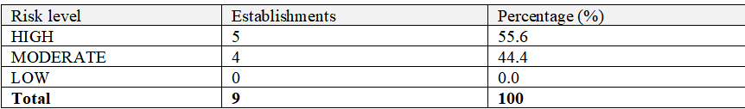
Result and discussion
Automated Risk Assessment and Notifications=
When Run Prescription is clicked, the system calculates the score for every establishment and classifies it as LOW, MODERATE or HIGH.
Table Risk level distribution of establishments

Slide 11
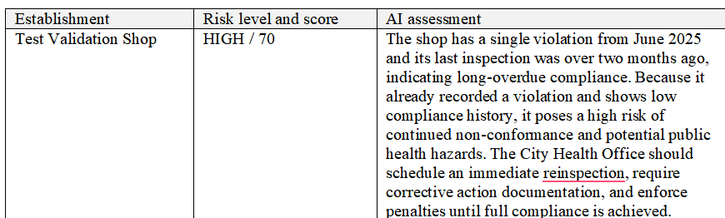
Table Sample system-generated risk narrative
An AI-assisted narrative layer supports the scoring engine. For a selected establishment, it writes a short plain-language assessment that explains why the establishment has its risk level and what the City Health Office should do, using the score, violation count, last inspection date and the system recommendations. The narrative does not change the score or the risk level. Requests are limited to 10 per hour per user, and results are stored so the same establishment is not analyzed again unnecessarily. The narrative is a writing aid and can be imprecise. The sample System-generated risk narrative says the last inspection was over two months ago, although the report is dated June 2025, so inspectors should always check it against the score breakdown.

Slide 12
THANK YOU

